Slide 1
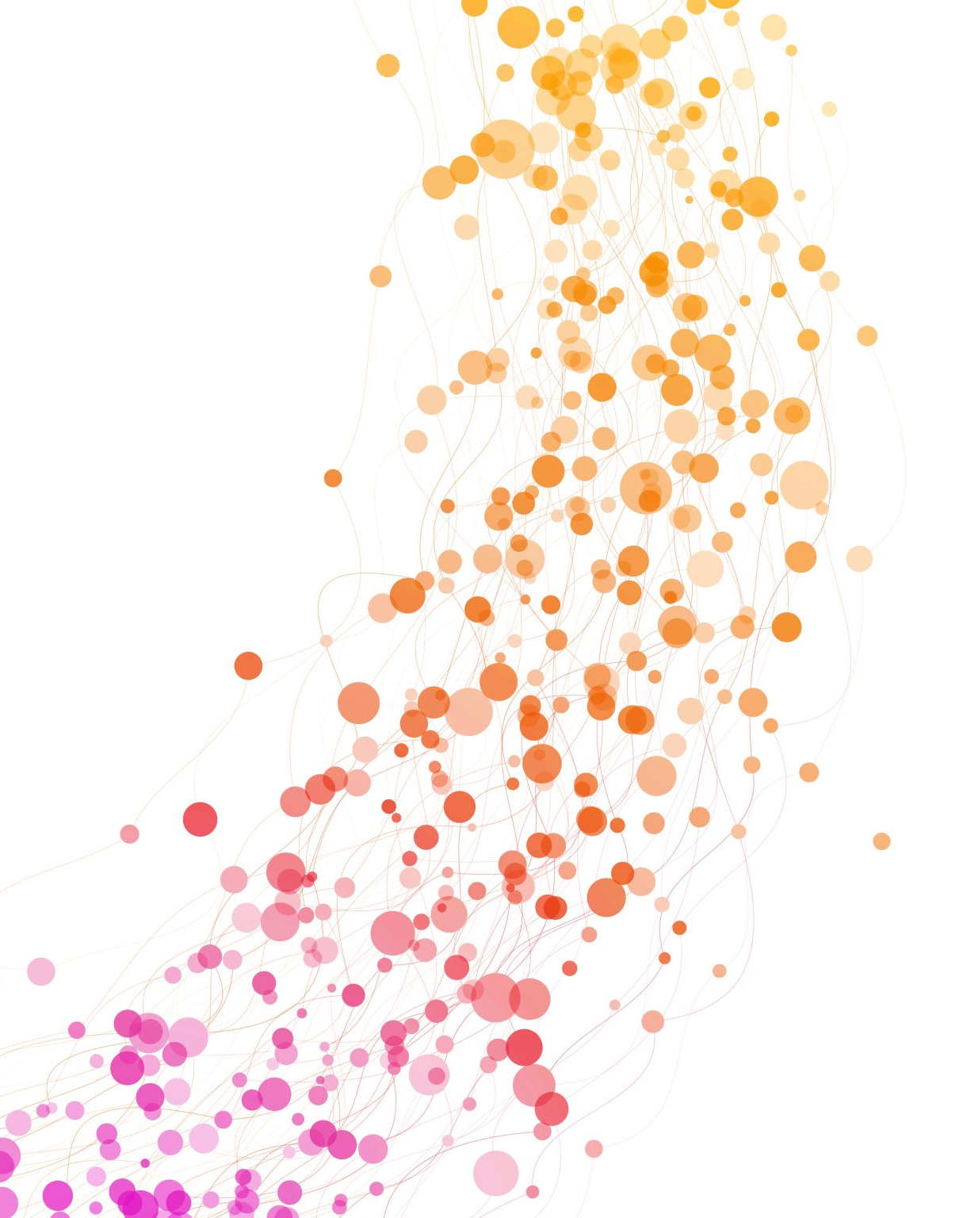

QUANTUM COMPUTER
CS3650 FINAL PROJECT
Nhan Thai

Slide 2
CONCEPT

Slide 3
Classical computers
Classical computer does all kind of stuff with the combination of 0 and 1. By switching around 0 and 1, we can get the value that we want
For example, A is 01000001 in binary code
Moreover, these computers only understand the combination of 0 and 1. We can relate it to the coin where it only has tail and head.

Slide 4
Quantum computers
In quantum computer, we will spin the coin, just like we spin 0 and 1
Quantum mechanics is the branch of science, specifically a branch of physic where we study of things that are extremely tiny
In quantum computer, there are some concepts that we should know

Slide 5
Superposition
To explain this concept, let’s take the coin as an example. We always know if the coin is head or tail by place it on somewhere. However, when we spin the coin, we could not tell if the coin is head or tail. Therefore, superposition is the state where the coin has the combination of head and tail
It also means the quantum bits have the combination of 0 and 1

Slide 6
Entanglement
It means something intertwine. If two coins are entangled, when we spin them and wait for it to lie down, if we know the face of one coin, we can measure the other face of one coin. And if we measure at the exactly same time, we will find that they are correlated.
Entanglement means that we have two objects and when we entangle them, they become connected. They are sorted of permanently connected to each other

Slide 7
Interference
A good example is how a noise-cancelling headphone works, it creates a opposite wavelength to the one that it receives, so they can cancel each other.
In quantum computers, we have two types of interference, the constructive and destructive one. Constructive interference amplifies the wavelength until the signal get larger while the destructive one will cancel them.
Because of that, it will help amplify the signals that are toward the right answers while cancel the ones lead to wrong answers

Slide 8
How quantum computer is built
Combining all the quantum mechanics that mentioned above: superposition, entanglement and interference
Need an object or physical device, we call it qubit or quantum bits that can handles things and be put in superpositions
Need a device that supports quantum state and manipulate it, in quantum computer, it is superconducting qubits

Slide 9
Quantum bits
Quantum computers use quantum bits, or qubits, is the fundamental unit of information in a quantum computer.
Unlike classical bit, it can represent both 0 and 1 simultaneously.

Slide 10
Conclusion
A quantum computer is a type of computer that uses quantum mechanics to perform calculations. Quantum computers use quantum bits, or qubits
In a quantum computer, quantum mechanics is used to manipulate the state of qubits. By applying quantum mechanical principles, such as superposition, entanglement and interference. This allows quantum computers to perform certain calculations much faster than classical computers.

Slide 11
A quantum computer can perform calculations on these qubits in order to solve problems that are difficult or impossible to solve using classical computers. The principles of quantum mechanics are what make quantum computers so powerful and different from classical computers.
In recent years, significant progress has been made in the development of quantum computers, and many experts believe they have the potential to revolutionize the field of computing.

Slide 12
PROJECT

Slide 13
Quantum Coin Toss
In this project, I will run the quantum coin toss stimulation with one coin only, two coin, and three coin. Besides, I also add some stuff to make the case where two coins become entangled
Here is the demo that I run, and I will explain how it work.

